Slide 1

Bangladesh University of Business and Technology
Department of CSE

Slide 2
GROUP MEMBERS :
NAME | STUDENT ID
Fardin Ahmed | 22234103159
Rahat Bin Israil | 22234103139
Md. Saidul Islam | 22234103142
Maria Akter Kona | 22234103146
Jannatul Fardous Riya | 22234103135

Slide 3
THE BIG IDEA Employee Management System
Submitted To :
Khan Md. Hasib
Assistant Professor
Department of CSE, BUBT

Slide 4
WHY THIS IDEA IS SO BIG ?
One can manage his employees very easily.
Manage employee from anywhere.
Paperless activities.
User-friendly.

Slide 5

What is EMS..??

Slide 6
Introduction
An Employee Management system is a software solution that helps organigations effectively manage their workforce.It streamlines tasks such as employee data management, employee infomation, their performance and more.

Slide 7
Communication and Collaboration:
Effective communication and collaboration are vital for a cohesive and productive workforce. Our system incorporates features such as employee directories, internal messaging systems, and team collaboration tools. This facilitates seamless communication across departments, improves teamwork, and encourages knowledge sharing within the organization.

Slide 8
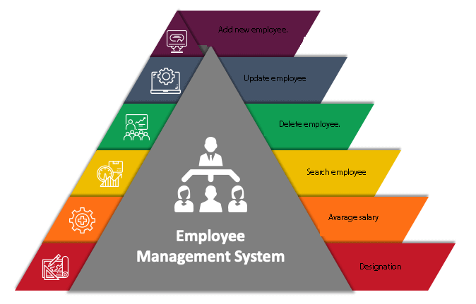
Target and Goal

Slide 9
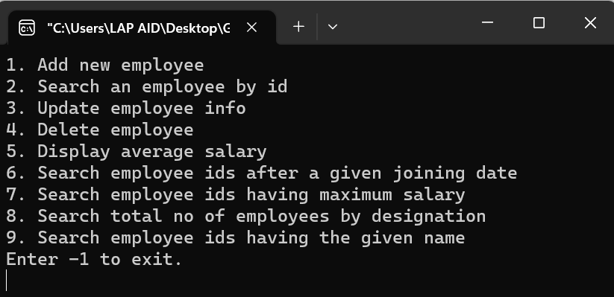
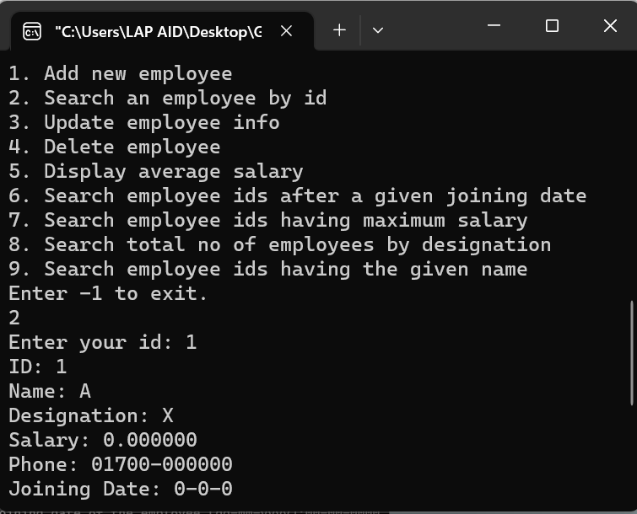
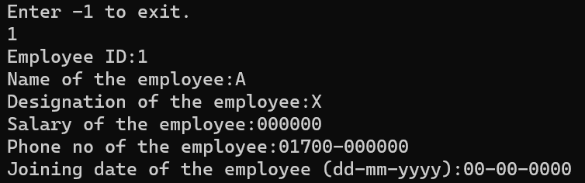
User Interface :

Slide 10
For managing Inventory
Simple but effective
Uses of EMS

Slide 11
Equipment | Capacity
Processor | Intel i3 6th Gen
Operating System | Windows 11
Memory | 8 GB DDR 3
Storage | 512 GB Hard disk drive
IDE | Code Blocks 20.03
Compiler | Mingw 64bit
Environment

Slide 12
Down Sides
Non clickable
Not fast enough
Backdated user interface

Slide 13
Future Aspirations
Improve our user interface .
Making EMS web supported .
Making EMS multiplatform .
Creating an eco-system for small businesses .

Slide 14
Conclusion:
our Employee Management System offers a comprehensive solution to streamline and optimize employee management processes. By leveraging technology, we aim to enhance productivity, improve communication, and foster a positive work environment. With its intuitive interface and robust features, our system empowers organizations to effectively manage their workforce and drive success.

Slide 15

That's a wrap
Thank You Very Much !

Slide 16

Thanks From:
Md. Rahat Bin Israil
Md. Saidul Islam
Maria Akter kona
Md. Fardin Ahmed
Jannatul fardous Riya

